Slide 1









MTH208 Project
Presented by Group 16
Daksh Agrawal (230337)
Kaushik Raj Nadar (208160499)
Parv Mehta (230741)
Arpan Samanta (241080058)
1

Slide 2
Why???
We are a group of passionate developers from the VatsApp organization with years of experience in building apps across various domains. Despite our consistent efforts, we have faced significant challenges in making our apps popular and ensuring they stand out in a competitive market. In response to this, we are shifting our focus towards a data-driven approach. Our plan is to analyze how the top apps in different categories outperform others by studying key performance indicators such as downloads, ratings, features, user engagement, and more. By understanding these trends, we aim to refine our strategies and create more impactful and successful applications.
2

Slide 3
Goals
Analyze how app ratings are distributed across categories or app types
Understand which app categories or types consistently receive higher or lower ratings
Analyzing the number of downloads for various categories
Does Design of icons affect ranking?
Compare the above features for apps in US and India
Distribution of Price range of top paid apps
Analysis of how many Apps a particular company makes and does the name of the manufacturing company affect the number of downloads
Identify leading competitors and assess where an app stands relative to others in the same category.
Discover which categories are more competitive or saturated and which may have growth opportunities.
3

Slide 4
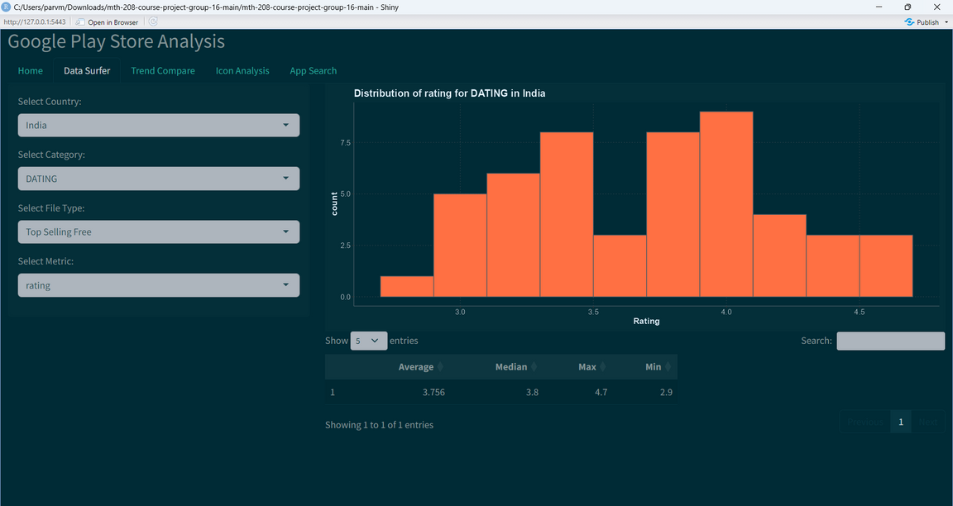
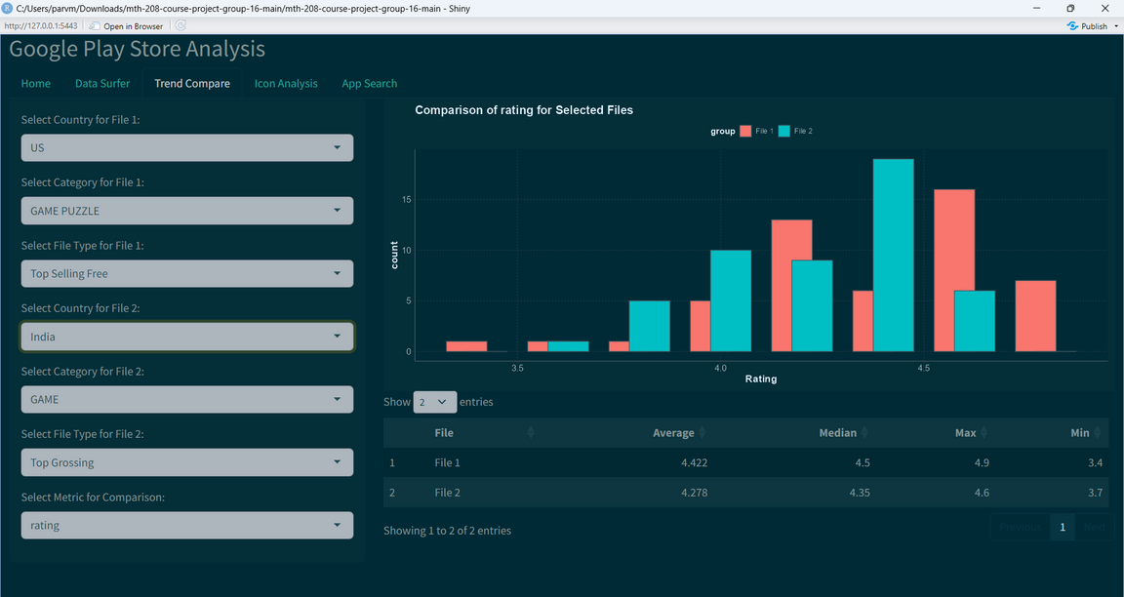
Result
Distribution of the Ratings for Dating Apps in India
Comparison of free Puzzle Games in US with top grossing Games in India
4

Slide 5
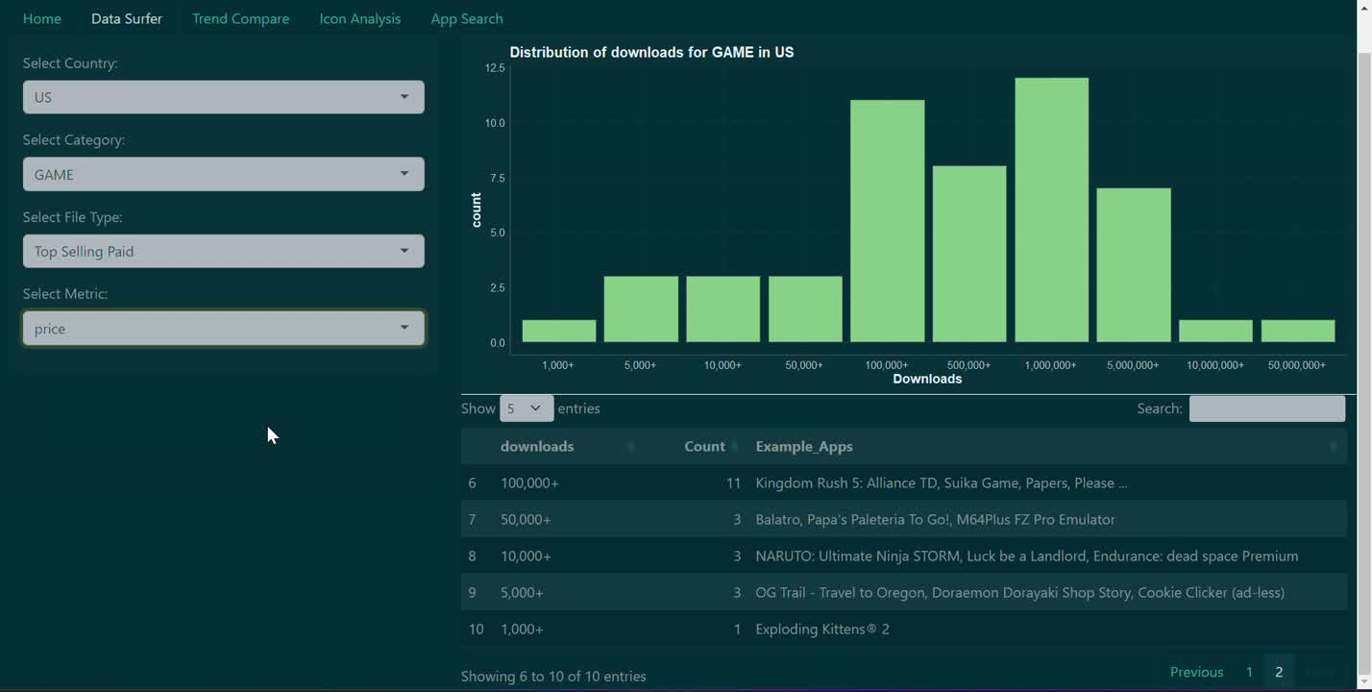
Demo
5

Slide 6
Thank
You
6

